Slide 1
Impact of Aspect Ratio on Cavity Flows for Pitting Corrosion in Oil Pipelines
Timothy Lee
UC Berkeley, Dept of Material Science and Engineering
EPS236 Project A
Fall 2013

Slide 2
Summary
Wrote a program to solve the Navier-Stokes equations on a 2D-grid to simulate pressure-driven fluid flow in a pipeline with a cavity

Slide 3
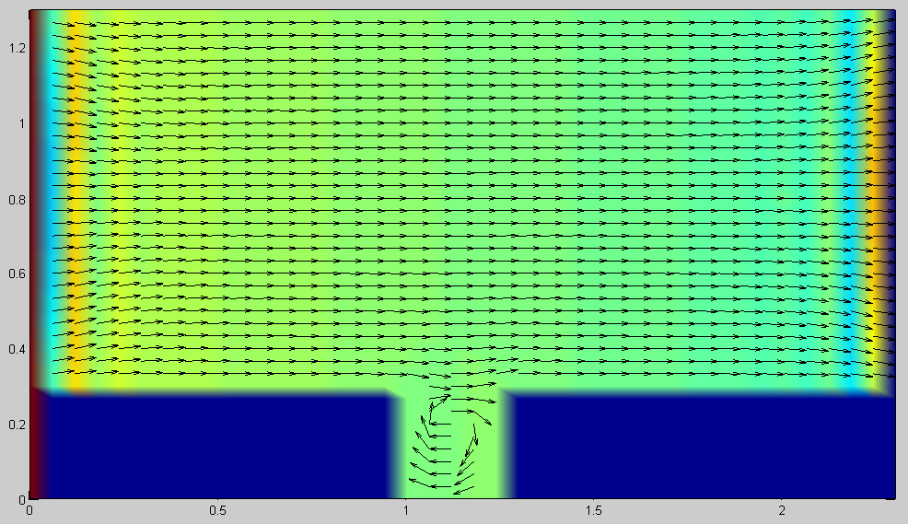
Geometry 1: Pressure Driven Cavity Flow
Figure 4: A 1:1 aspect ratio cavity in a pipeline. Mouth of the cavity is 30% of the height of the pipeline.
At this ratio, pressure flow will create a convection current that will pull fluid out of the cavity

Slide 4
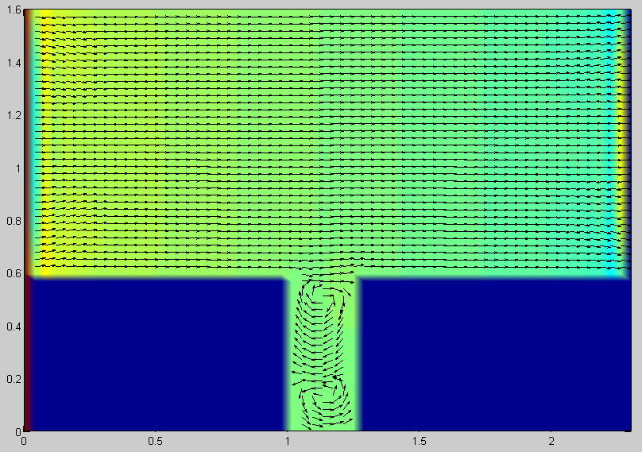
Geometry 1: Pressure Driven Cavity Flow
Figure 5: A 2:1 aspect ratio cavity in a pipeline. Mouth of the cavity is 30% of the height of the pipeline.
The deeper the pit, a second convection current is created at the bottom of the cavity. Thus, solution at the bottom of the cavity cannot be pulled up out of the cavity with fluid flow.

Slide 5
References
http://lorenabarba.com/blog/cfd-python-12-steps-to-navier-stokes/

